Slide 1
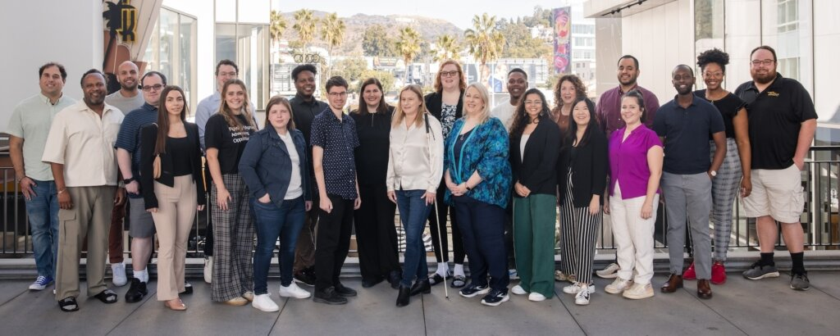
Accessibility and Universal Design for Legal Professionals
NACDL | March 28, 2024

Slide 2
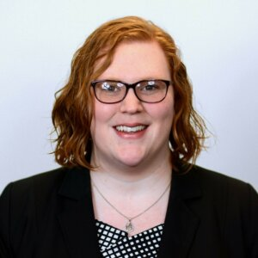
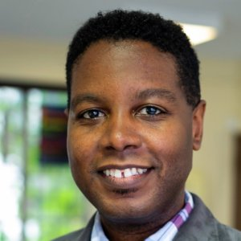
Today’s Facilitators
Ariel Simms (they/she), President & CEO at RespectAbility
Graciano Petersen (he/him), Senior Director of Talent, Culture and Training at RespectAbility

Slide 3
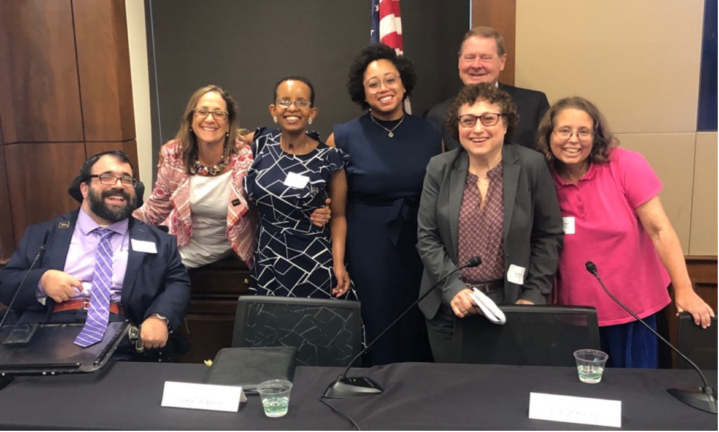
Who We Are
RespectAbility is a diverse, disability-led nonprofit. Our mission is to fight stigmas and advance opportunities so people with disabilities can fully participate in all aspects of community.

Slide 4
Today’s Learning Objectives
By the end of the session, legal professionals will be able to:
Explain the concept of accessibility, including legal requirements when working with disabled individuals
Articulate the basics of reasonable accommodations processes and general best practices
Describe key principles of universal design and plain language and apply them to various practices and approaches in legal settings
Implement 5 actions to support accessibility and broader disability inclusion efforts, including in their office, agency, and/or firm practices
Name at least 3 resources that can support them in improving accessibility, including access needs for disabled individuals and clients

Slide 5
Share in the Chat: How would you define accessibility?

Slide 6
Accessibility from the Start

Slide 7
What is Accessibility?
The design, construction, development, and maintenance of facilities, IT, programs, and/or services so that all people, including people with disabilities, can fully and independently use them.
Ensuring your intended audience can fully participate and/or act on the information being shared.
Access benefits everyone.

Slide 8
Accessibility Is Important For All
Curb cut phenomenon
20% of people in the U.S. are Deaf/Hard of Hearing; that is 48 million Americans
More than 1 million people in the U.S. are blind and more than 12 million have low vision
More than 5 million people in the U.S. are English language learners
It is likely that more than 40 million Americans have a learning disability, though many are undiagnosed or don't identify with the disability community

Slide 9
Make It Accessible
If something is accessible, your target audience can:
Participate
Understand
Engage or take action
Common types of access needs
Physical/mobility access
Sensory access (auditory, visual, olfactory, and environmental stimulation)
Cognitive access
Communication access, including language considerations

Slide 10
Legal Considerations

Slide 11
The Americans with Disabilities Act (ADA)
Title II of the ADA
Public entities, including the courts, court personnel, and court actors, including judges and attorneys
ADA Coordinators
Anti-discrimination and reasonable modifications
Overt, disparate impact, and failure to modify
Notes:
In addition to the ethical rules that govern attorneys, we also need to mention the Americans with Disabilities Act
Title II, which prohibits discrimination applies to all public entities, including courts and court actors (attorneys, staff, etc.)
Discrimination includes no overt discrimination, but also making reasonable accommodations to make sure programs and services are accessible to those with disabilities
We’ll be looking at potential accommodations at each stage of the process
Courthouses often have an ADA coordinator to help ensure accessibility (government entities with 50+ employees)

Slide 12
Title I of the ADA
Employees with disabilities are entitled to reasonable accommodations
Reasonable accommodations are modifications or adjustments to a job, the work environment, or the way things are usually done
These modifications or adjustments help disabled people perform the essential functions of their jobs and/or create equal opportunity in employment

Slide 13
Rights and Responsibilities
Rights
Effective communication
Access to programs and services
Responsibilities: Anti-Discrimination
Auxiliary aids and services
Reasonable accommodations (or modifications)

Slide 14
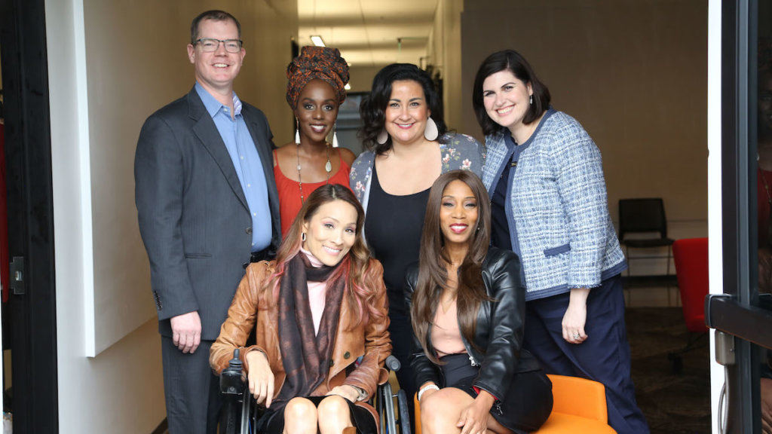
Accommodations
Some programming will require participants to request reasonable accommodations
Individualized inquiry, taking into account personal preferences
This may require offering and securing technology or software

Slide 15
What Are Examples of Accommodations or Supports?
Flexible working hours
Scheduled or frequent breaks
Captioning or CART
Large-print materials
ASL interpretation
Changes to team communication practices (i.e., using Zoom phone messaging over email)
Assistive technology/software
Durable medical equipment

Slide 16
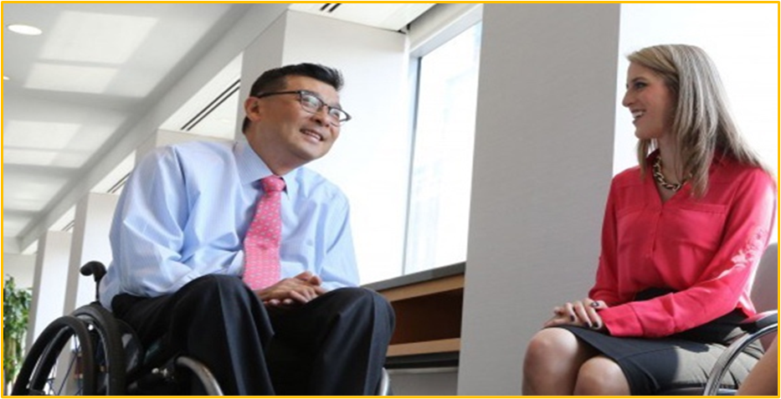
Accessibility for Legal System Participants
All people must be informed and aware of their rights, and potential consequences in the criminal legal system
In order to make the process accessible for those with a variety of access needs:
Make sure all universal design principles are in place
Ascertain what other accommodations a person may need

Slide 17
Share in the Chat: What things can you make accessible?

Slide 18
What Should Be Accessible?
Everything!
Digital resources
Print resources
Communications and information
Processes
Meetings and events
Meeting and event materials
Venues and physical spaces
Virtual spaces

Slide 19
Accessibility How-To

Slide 20
Accessibility Formula
Universal Design
Individualized Accommod-ations
ACCESS

Slide 21
Universal Design Principles
Equitable Use
Flexibility in Use
Simple and Intuitive
Perceptible Information
Tolerance for an error
Low physical effort
Size and space for approach and use

Slide 22
Resource Accessibility
To ensure content is as accessible as possible, check content for the following:
FLAC
Font
Always sans serif, readable size
Links
Embedded and descriptive
Accessibility Checkers
Flags major errors and also gives warnings and tips
Color
Contrast/conveying information

Slide 23
Plain Language
Communicating in a way that your audience can understand the first time
A general movement toward understandable information
Resources
Autistic Self Advocacy Network
www.PlainLanguage.gov

Slide 24
General Principles of Plain Language
Well-organized/easy to follow main ideas
Speaks to the reader (“You”)
Active voice
Present tense
Short sentences
Familiar words
Use lists and tables to simplify information
Images to enhance meaning

Slide 25
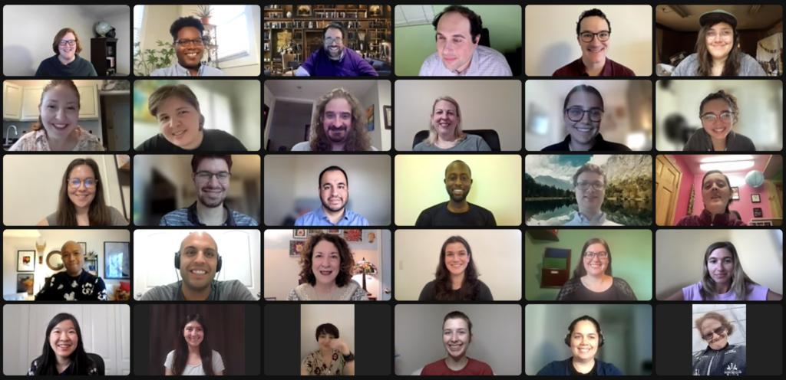
Ensuring Accessible Programming
At your first planning meeting, make sure to:
Confirm that all event locations are accessible.
Make sure that there are people in charge of accessibility checks with venues and online platforms.
Make it easy and comfortable for people to request accommodations beforehand; include this phrase in every registration form:
“Do you need any accommodations to
fully participate in this event?”
Offer and provide accommodations when requested
Assign/provide contact information of whomever is responsible for accommodations

Slide 26
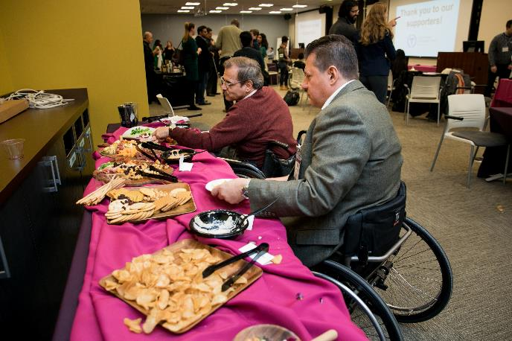
In-Person Meetings
Audiovisual needs
Captioning/CART
ASL Interpretation
Mix of table heights and seating options
Chair space/navigation for wheelchair/mobility aid users
Quiet room/sensory room – space for a break
Food labels with ingredients listed
Breaks

Slide 27
Best Practices for Virtual Meetings
Each person should say their name every time they begin speaking
As a general rule, any individual not speaking should be on mute
Give them an option to share thoughts if others are doing so verbally (chat box)
Read chat messages aloud
ASL interpreter video stays on the entire time
Have 10-minute breaks every hour or so
www.respectability.org/accessible-virtual-events

Slide 28
Additional Best Practices
Share materials in advance, including agendas, and notes/summary afterward
Presenting information in multiple ways
Audio description of visual information, including you!
Moderator/facilitator to help ensure full participation, including access check-ins
Language considerations
Evaluate meetings and events/solicit feedback
Accessible transportation
Childcare considerations (for longer events/meetings)
Access plan/policy, including preferred access service providers

Slide 29
Access Services

Slide 30
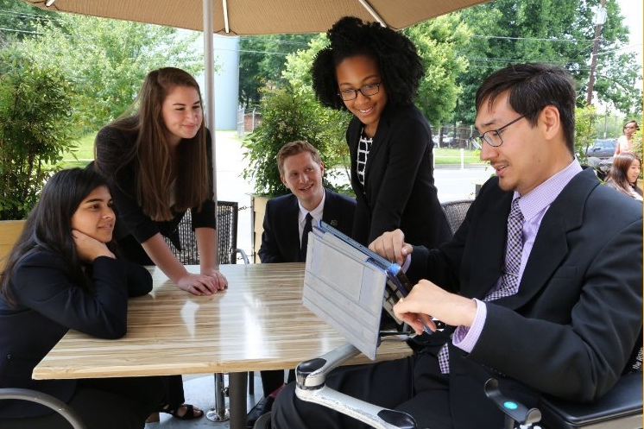
Communication Access Realtime Translation (CART)
Live transcriber – third-party captioning service
Provide names, proper nouns and technical vocabulary for more accurate captioning
Can be for platforms like Zoom or in-person on a separate screen or individual tablet
Note: Automatic captions using Artificial Intelligence (AI), while improving, will have more errors

Slide 31
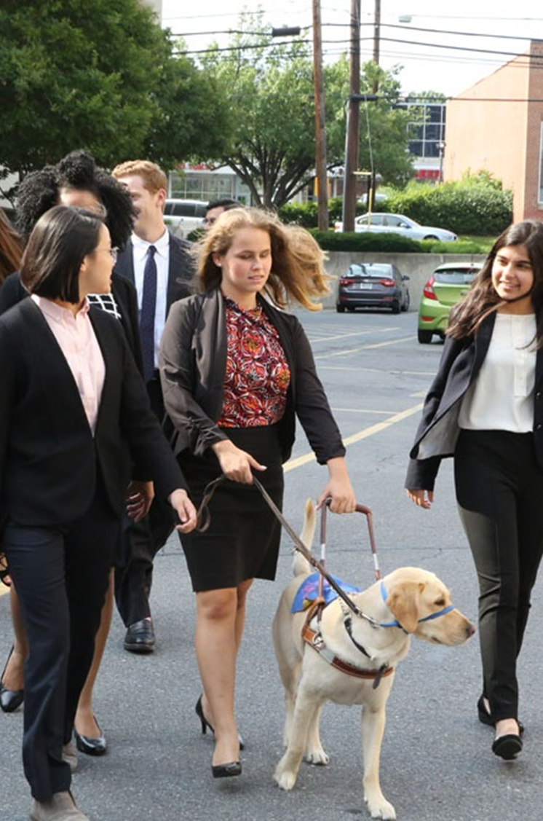
Benefits of Live Captioning
Greatly eases the cognitive load of a meeting or event
People who are Deaf/Hard of Hearing
People who have Learning Disabilities and slower processing
People whose first language is not English
Everyone! – Universal Design

Slide 32
Benefits of ASL Interpreters
If Deaf/hard of hearing individuals want to fully participate, ensure ASL interpreters for active participation
Note: ASL and English are two different languages
Share names of presenters and materials ahead of time so interpreters can become familiar with the materials

Slide 33
Live Audio Description
Speaker should describe what is on screen (PowerPoints or other visual aids)
NOTE: Even if you made the PPT accessible, people will not be able to use screen readers for the PPT being shown on screen (whether virtual or in-person) – send copy prior to event.
If video clips do not include audio description, the speaker should explain the visuals prior to showing the video
Resource on audio description

Slide 34
Continue Your Disability Inclusion Journey
Continue your learning:
Disability 101: Ensuring Best Practices in Disability Inclusion
Best Practices: Recruitment and Retention
Creating a Welcoming, Inclusive and Accessible Organization
Ensuring Accessible In-Person and Virtual Events
Living with a Disability in an Inaccessible World
Mental Health & Wellness in the Workplace
Disability Inclusion in Philanthropy
Email JakeS@RespectAbility.org for more information

Slide 35
Equity and Access Webinar Series
Disability 101
Disability History
How to Ensure Accessible Events
How to Recruit, Accommodate and Promote People with Disabilities for Paid Employment, Volunteer Leadership and Board Positions
How to Ensure A Welcoming Lexicon and Inclusive Storytelling
How to Ensure Accessible Websites, Social Media and Inclusive Photos
Premium Skills Workshop in Social Media Accessibility
How to Ensure Legal Rights and Compliance Obligations
Watch Recordings, Download Transcripts and PowerPoints:
https://www.respectability.org/accessibility-webinars/

Slide 36
FOR MORE INFORMATION
Ariel Simms, President and Chief Executive Officer, ArielS@RespectAbility.org
Graciano Petersen, Senior Director of Talent, Culture and Training at RespectAbility: GracianoP@RespectAbility.org
Jake Stimell, Training & Consulting Associate: JakeS@RespectAbility.org

