Slide 1

Policing the Police
August 2020
Law Enforcement Accountability
Database Project

Slide 2
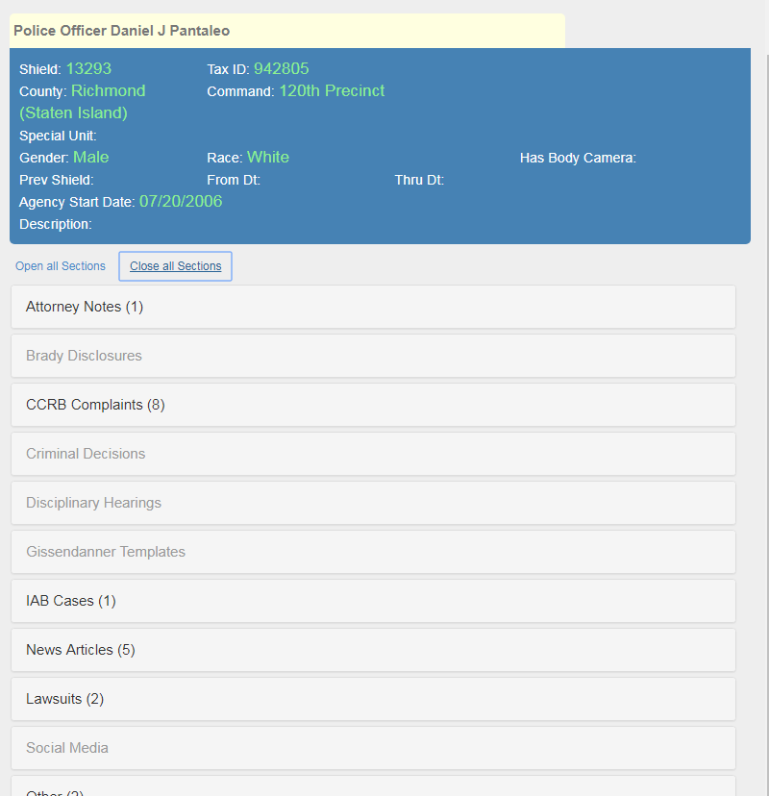
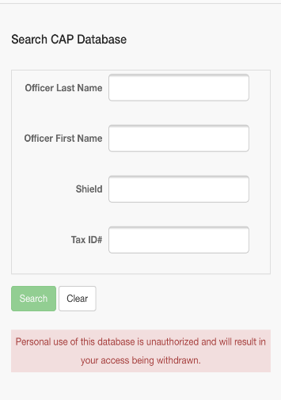

Legal Aid Society
Database
?

Slide 3
Database Sources
Publicly Sourced Data
Work Product Data
Civil rights lawsuits filed against police officers obtained through PACER, state court websites, and courthouses;
Media reports about police misconduct tracked through news alerts, web scraping of local newspapers, and relationships with local reporters;
FOIA requests for overtime data, decertification data, declined prosecutions, civil rights notices of claims and lawsuits, civilian complaints, use-of-force reports, and other jurisdiction-dependent public data;
Civilian complaint data made through public sources like Open-Police Complaints or Raheem.AI
Judicial decisions available in legal databases like Westlaw and Bloomberg
Info obtained from lawyers and clients about police officers & actions of prosecutors
Info obtained by investigators, including social media posts of police officers that are potentially useful as impeachment material;
Court disclosures made about officer misconduct under protective orders
Internal disciplinary data obtained via a subpoena
Judicial findings that are not publicly reported;
Case dismissals as a result of other types of police misconduct or inaccuracies
Arrest data analyzed to identify suspicious patterns of arrests/dismissals.

Slide 4
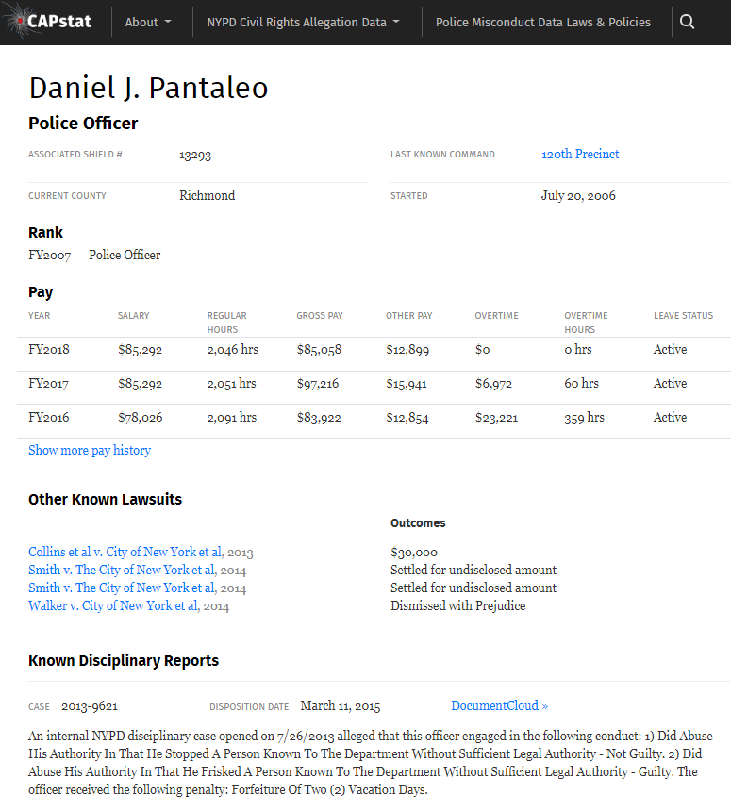
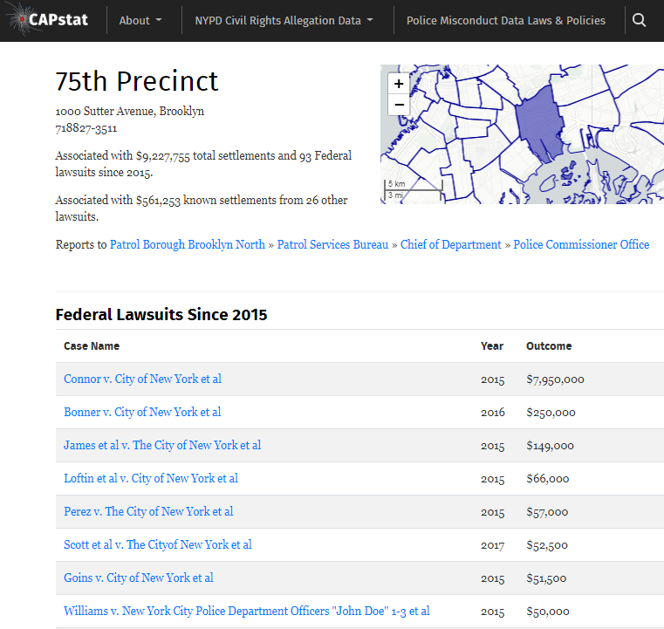
WWW.CAPSTAT.NYC

Slide 5
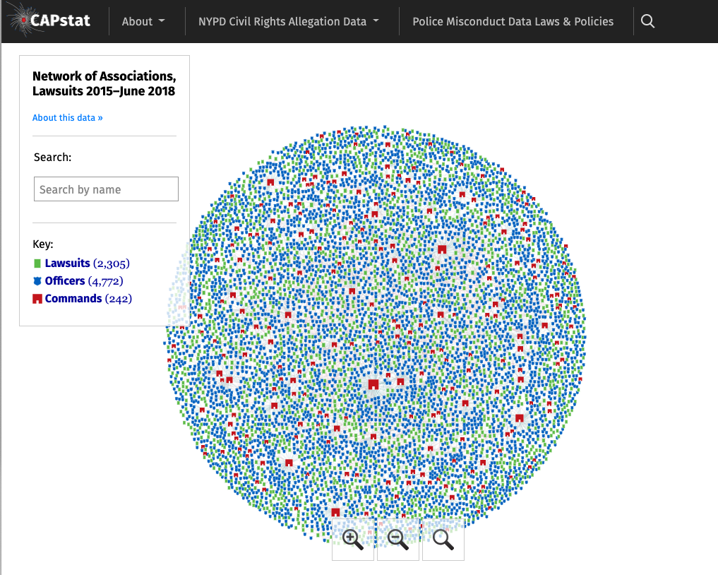
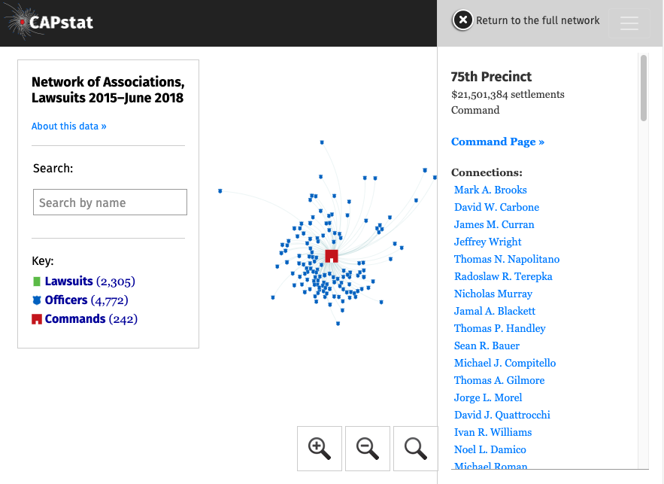

Slide 6
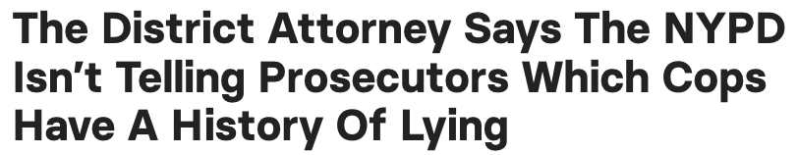

Source: https://www.buzzfeednews.com/article/mikehayes/nypd-cops-lying-discipline-disrict-attorneys-prosecutors

Slide 7
P.D.
Pressured To Disclose
Defender Database
THE
VIRTUOUS
CYCLE
Use
P.O. Data
In Media
Use
P.O. Data
In Court
D.A.’s
Create
Database

Slide 8

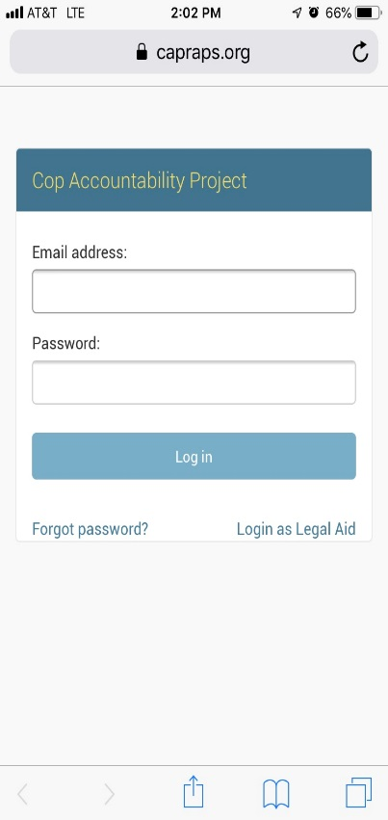
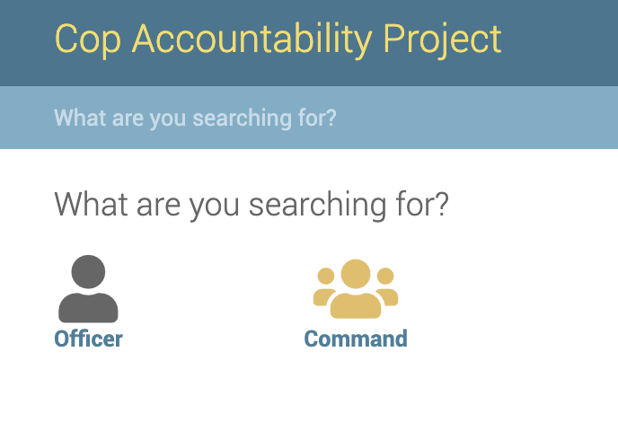
Database Application
Mobile & Desktop Friendly
Cloud-based
Customizable
Supports Cross-organizational Collaboration
Track Public and Confidential Data
Built to handle any type of misconduct data
Officer and Command Based Profiles

