Slide 1
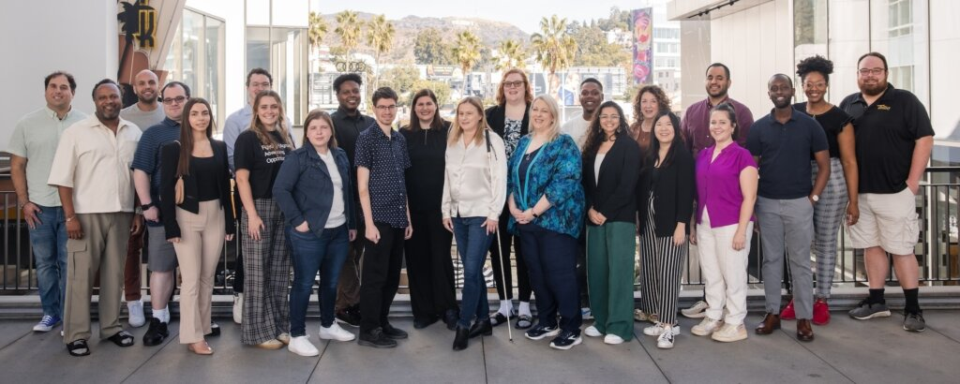
Fostering Disability-Inclusive Cultures and Workplaces
NACDL | April 25, 2024

Slide 2
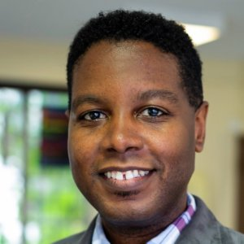
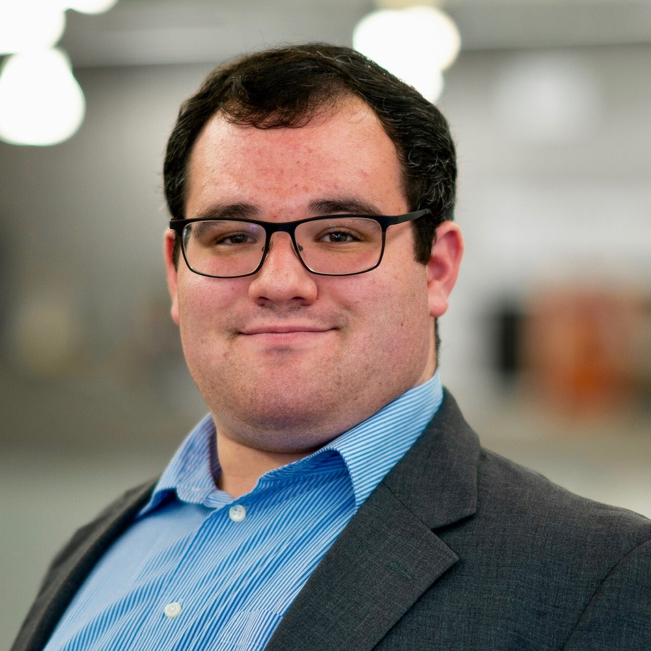
Today’s Facilitators
Graciano Petersen,
Vice President, Talent, Culture, and Learning
Eric Ascher,
Senior Associate, Communications

Slide 3
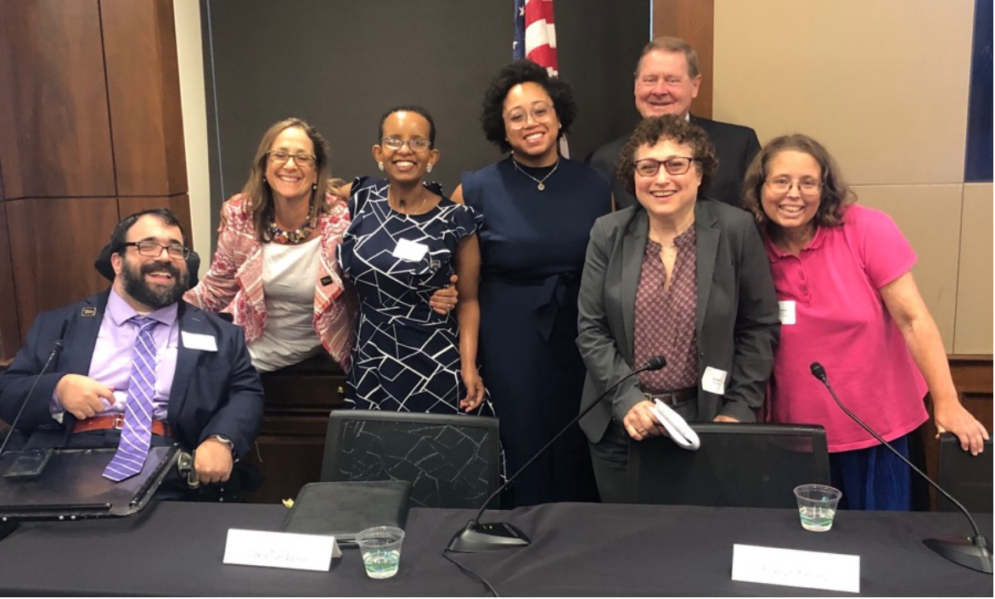
Who We Are
RespectAbility is a diverse, disability-led nonprofit.
Our mission is to fight stigmas and advance opportunities so people with disabilities can fully participate in all aspects of community.

Slide 4
Today’s Learning Objectives
By the end of the session, attendees will be able to:
Identify 3 action steps they can take to foster inclusive employee development and advancement opportunities
Articulate the basics of reasonable accommodations processes for employees with disabilities
Support implementation of disability inclusion efforts within organizations, offices, agencies, and/or firms
Highlight the importance of intentional and inclusive marketing and communications practices as part of a larger disability inclusion strategy
Name at least 3 resources that can support them in providing reasonable accommodations and fostering disability-inclusive cultures and workplaces

Slide 5
Share in the Chat: How do you make a workplace inclusive?

Slide 6
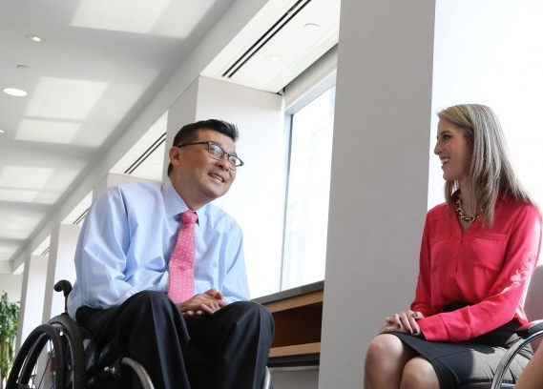
Steps to Creating an Inclusive Workplace
Recruit candidates from a diverse pool, including candidates with disabilities
Create a welcoming workplace where employees feel comfortable disclosing their disabilities and requesting accommodations
Ensure that all events and social media posts are accessible and inclusive of people with disabilities, to attract diverse staff, board members and volunteers

Slide 7
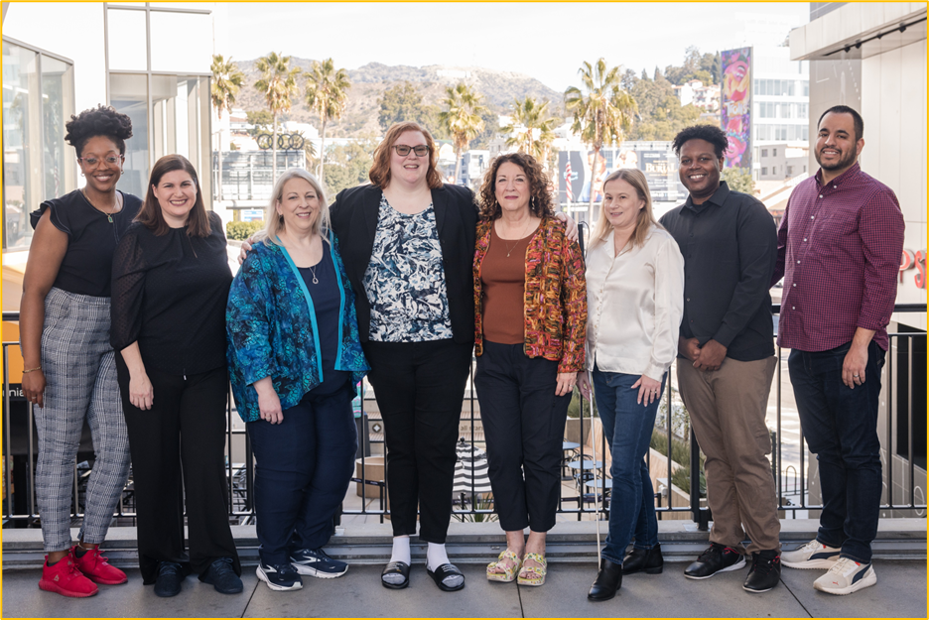
Partner with and Learn from Groups Led by People with Disabilities
People with disabilities know what solutions work for them!
Now we must move toward a model that focuses on inclusivity, intersectionality, and eliminating the barriers created by societal choices
These solutions must be led by people with diverse identities, backgrounds, and disabilities

Slide 8
Tips for Organizations and Employers

Slide 9
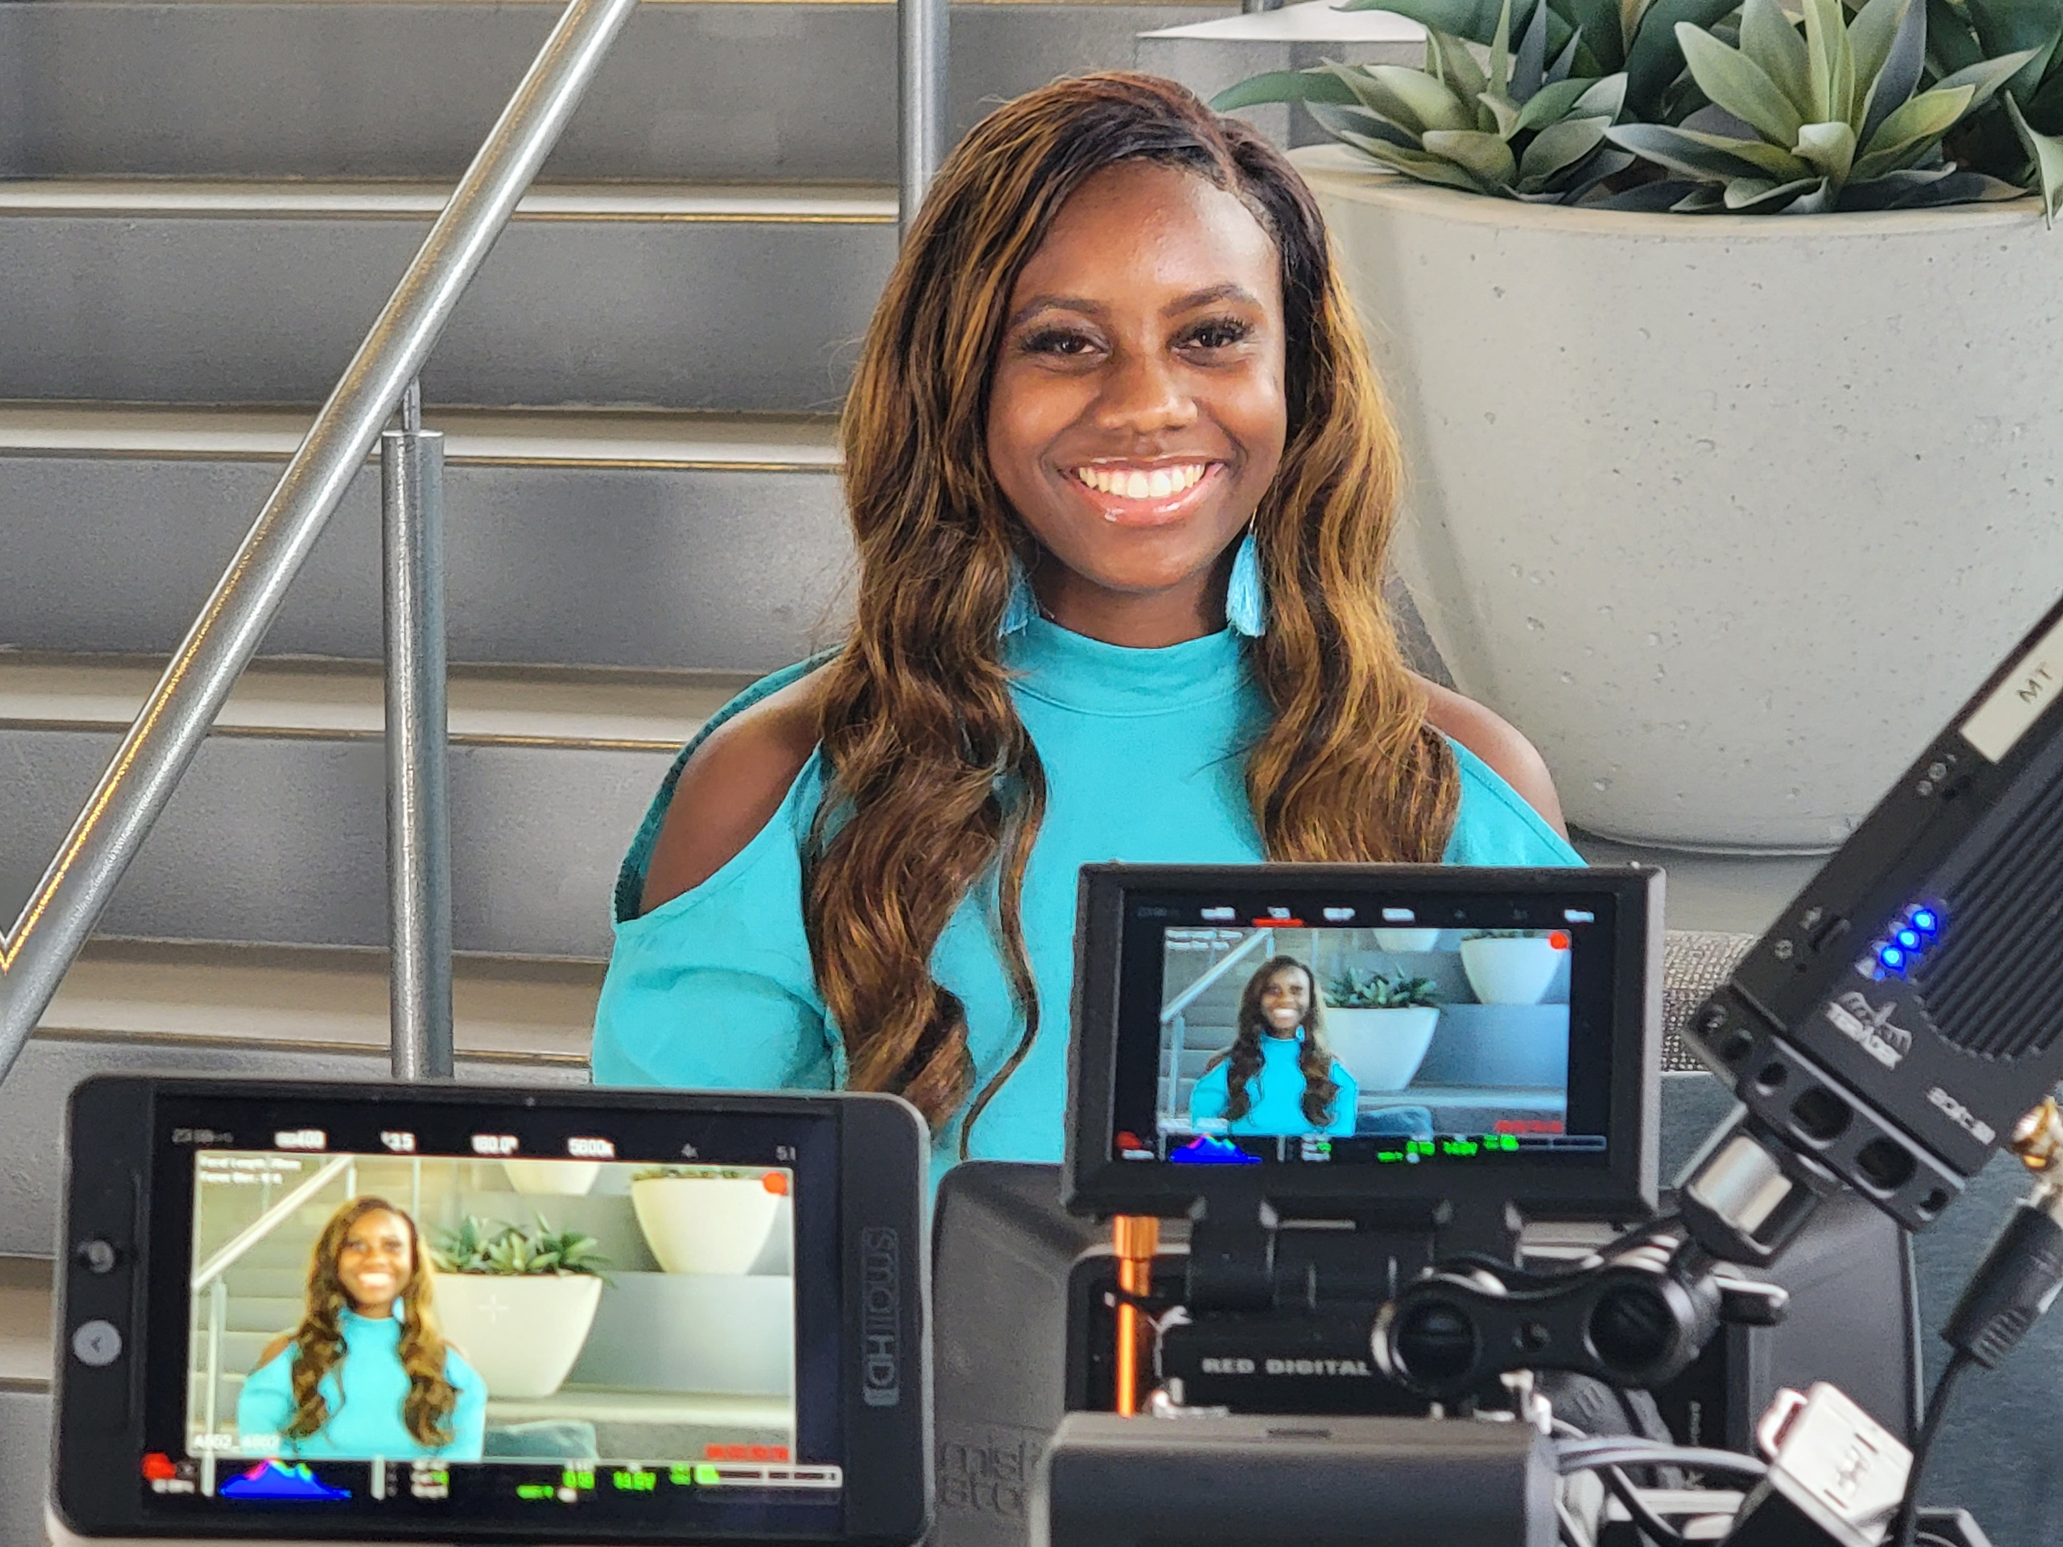
Be Transparent About Inclusion
The message that all people are of equal value and must be respected and treated fairly, must be communicated by the leadership of your organization.
Attract clients with disabilities by making your efforts towards inclusion readily available and easy to access.

Slide 10
How Can Your Organization Address This?
The ABA recommends that organizations:
1. Acknowledge the issues
2. Assess your organization’s culture, philosophy, and history 3. Define your organization’s goals 4. Evaluate your organization’s policies,
protocols, and practices 5. Invest in education, training, guidance, and support 6. Change your policies and practices 7. Track (progress)
www.americanbar.org | www.abacle.org

Slide 11
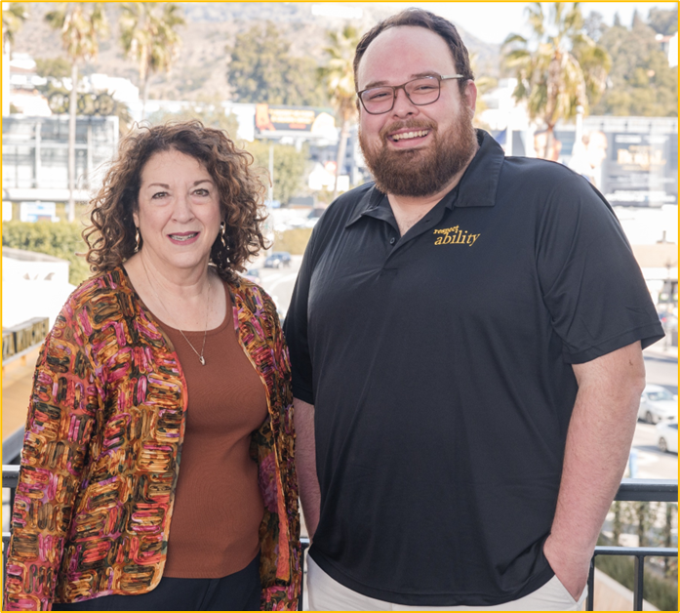
Set SMARTIE Disability Inclusion Goals
SMARTIE: Specific, Measurable, Achievable, Relevant, Time-Bound, Inclusive, and Equitable
Key goals can include using free accessibility tools and practices to ensure online events are screen reader accessible and have captions
An easy-to-meet goal is ensuring all in-person events are in fully accessible meeting spaces
Ask clients about any disability accommodation needs

Slide 12
Recruit Diverse Talent

Slide 13
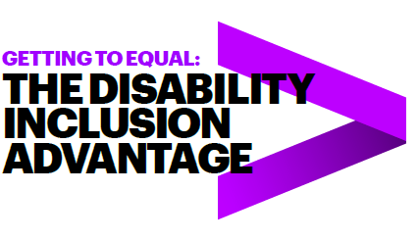
Benefits of Hiring People with Disabilities
Over four years, the Champions who embraced the talent of workers with disabilities vastly outperformed their peers. They had:
2X higher income
30% higher economic profit margin
Up to 30% less staff turnover
Followed 140 US companies from 2015-2018
45 Inclusion Champions, 95 peer companies
Read the full study online!
* Study completed by Accenture, Disability:IN and the American Association of People with Disabilities
Notes:
A 2018 study by Accenture and Disability:IN—reported that companies embracing practices that support and encourage individuals with disabilities in the workplace saw their bottom line improve. Strong DE&I practices were associated with up to 30% less staff turnover, double the net income, and a 30% boost in economic profit margin, compared with their peer companies that scored lower on DEI practices. So there’s no reason that employers shouldn’t promote these practices for their employees!

Slide 14
Recruit Talent with Disabilities
People with disabilities are loyal to our employers and are used to solving problems creatively
People with disabilities are a largely untapped talent pool

Slide 15
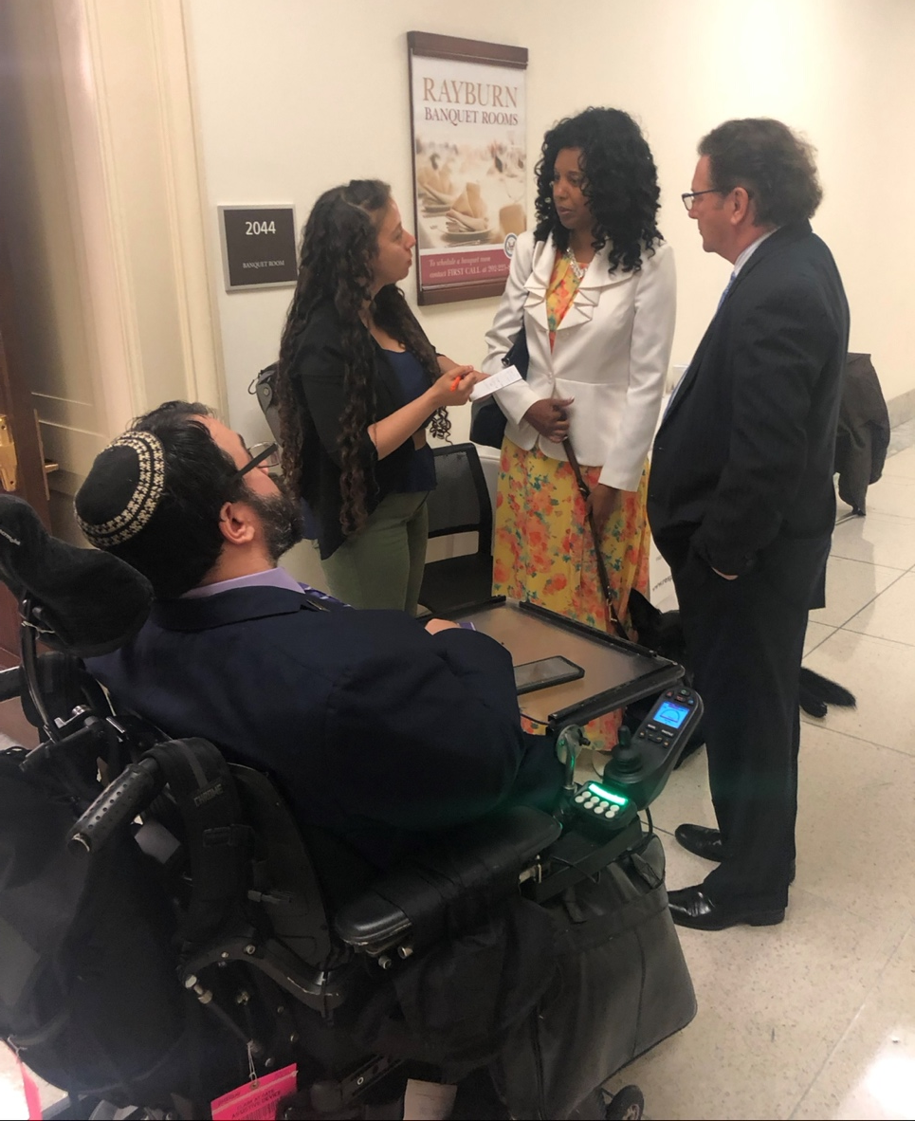
Resources Are Available To Teach You What You Don’t Know
If you are new on your disability inclusion journey, the questions of what to do next may seem daunting.
Yet people with disabilities have been succeeding in the workplace for decades, and there are resources to help.
These include:
RespectAbility, Best Practices for Employers
TAPAbility, which can source talent
AskJan.org, which can problem solve inclusive employment questions for free
Notes:
Here are some great resources that can help you on your disability inclusion journey and help employers learn best practices, source talent, and learn about ADA compliance and accommodations in the workplace.

Slide 16
Disability Inclusion at Your Organization
Volunteer
Opportunities for schools, summer jobs, internships, disability service providers
Leadership roles like boards and committees
Staff
Competitive integrated employment
Hire and promote
Having employees with disabilities at all levels of the organization is one way that nonprofits can improve the accessibility of their programs and better understand the ways that disability intersects with the mission

Slide 17
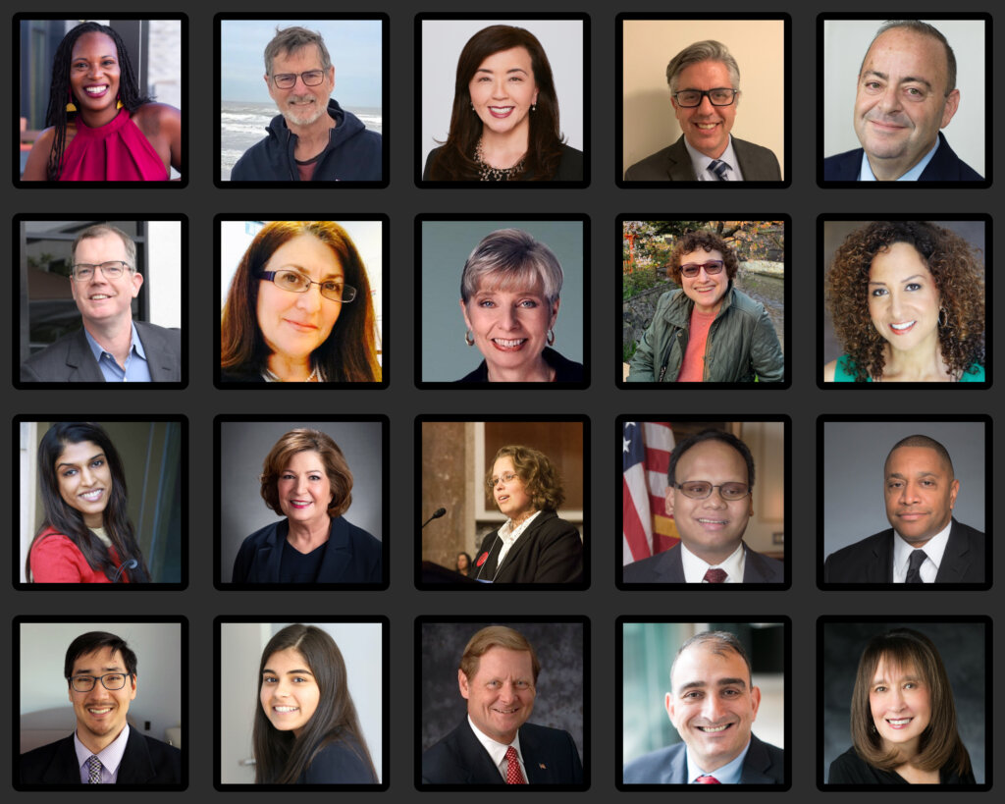
Lived Experience Makes for an Incredible Board!
RespectAbility Board members consist of a diverse group of thought leaders in the entertainment, policy, corporate, nonprofit, and faith inclusion worlds.
Their varied experiences and perspectives make for stronger decisions on the direction of the organization.

Slide 18
Representation at RespectAbility
RespectAbility is a “Nothing about us, Without us Organization.”
Over the last two years, over 47% of hires represent non-white communities and at least 85% have a disability.
Organization Level + Number | People of Color | White | Disability | LGBTQIA+ | Women/ Non-Binary | Men/Male-Identifying
Board (34) | 53% | 47% | 52% | 6% | 52% | 48%
Staff (25) | 38% | 63% | 80% | 45.8% | 56% | 44%
Senior Staff (7) | 43% | 57% | 71% | 43% | 57% | 43%
Fellows (229 alumni) | 46% | 54% | 90% | 22% | 62% | 38%

Slide 19
How to Recruit, Accommodate, and Retain Diverse Talent

Slide 20
Create a Welcoming and Inclusive Culture
Eliminate ableist and discriminatory language from job descriptions
Physical components (e.g., being able to lift 30 pounds) may only be in a job description if actually an essential function of the job
Encourage questions regarding accessibility and disclosure of disability
Respect the fact that disclosure is highly personal and may take time
Don’t micromanage the completion of tasks or when tasks get completed
Important to evaluate what work really needs to be done synchronously
Allowing employees to set their own schedules allows them to prioritize self-care
Encourage senior managers to be open about who they are
Have leadership talk about and acknowledge importance of accessibility and disability inclusion
Notes:
https://seramount.com/resources/creating-successful-self-id-campaigns-to-foster-inclusion

Slide 21
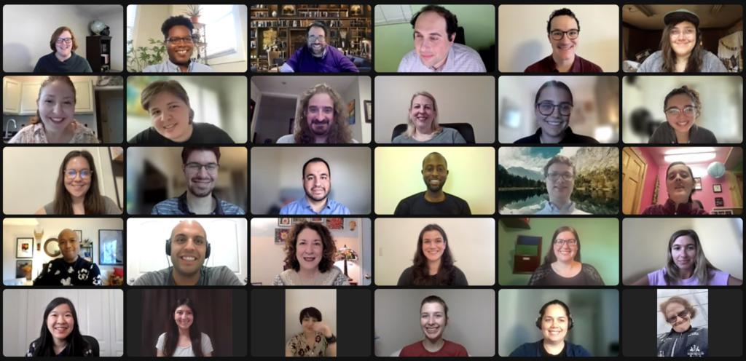
Review Your DEIA Practices
1. Employment and volunteer practices, encompassing but not limited to accommodations, talent recruitment, and retention policies.
2. Facilities and events, use only accessible spaces and practices and promoting universal design, benefiting older adults and those with disabilities.
3. Online Accessibility, ensuring websites and social media comply with the most recent Web Content Accessibility Guidelines so all people can benefit and participate in your work and success.
4. Are we at the table?: Whether people with disabilities are centered in decision making around issues that impact them.
Notes:
Ask yourself, are you consulting with people w/disabilities?
People with disabilities have a voice that should and must be at the table from the beginning of any planning process and should never simply be an after-thought. As I said a couple slides ago, “Nothing about us without us.”

Slide 22
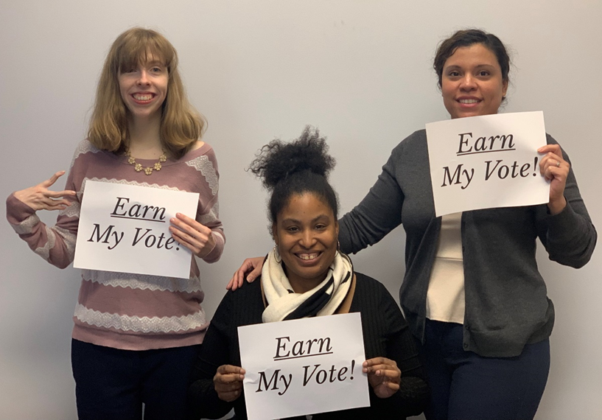
Support Diverse Candidates
Support disabled employees by establishing employee resource groups (ERGs) and prioritizing accessibility in all ERG and Diversity Equity and Inclusion (DEI) events
Encourage seeking and using accommodations to help one be more successful
Check in with each person to see what they need
Remove physical and other barriers
Screen readers, captions, wheelchair accessibility
It is important to always ask employees what they need to thrive in your workplace.

Slide 23
Create An Access and Communication Policy
Process for requesting/providing accommodations and auxiliary aids and services
Employees
Non-employees/public
Point of contact in the agency/responsible party
Preferred contractors/interpreters
Grievance procedure
Ongoing training/orientation for new employees

Slide 24
Title I of the Americans with Disabilities Act (ADA)
Employees with disabilities are entitled to reasonable accommodations
Reasonable accommodations are modifications or adjustments to a job, the work environment, or the way things are usually done
These modifications or adjustments help disabled people perform the essential functions of their jobs and/or create equal opportunity in employment

Slide 25
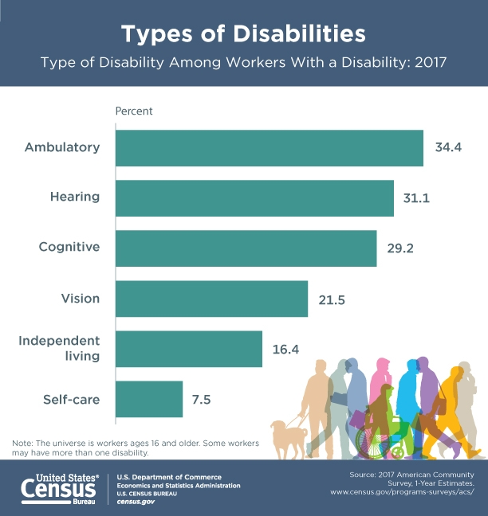
Defining Disability
The ADA defines disability as “a physical or mental impairment that substantially limits one or more major life activities.”
Major life activities include such activities as caring for oneself, performing manual tasks, walking, seeing, hearing, speaking, breathing, learning, and working.

Slide 26
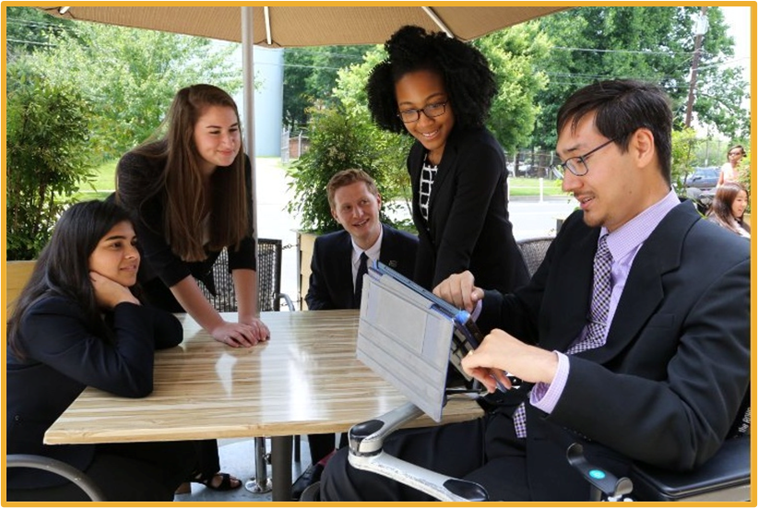
Requesting Accommodations
Typically starts with a request from an employee, but best practice is to proactively offer accommodations to all employees
Individualized inquiry, taking into account personal preferences
Interactive process between an employee and employer to find the right solution

Slide 27
What Are Examples of Accommodations or Supports?
Flexible working hours
Scheduled or frequent breaks
Captioning or CART
Large-print materials
ASL interpretation
Changes to team communication practices (i.e., using Zoom phone messaging over email)
Assistive technology/software
Durable medical equipment

Slide 28
Sample Accommodations Employees Should Know About
Flexible scheduling
Work optimally during hours of increased attentiveness
Modified break schedule
Mental rest to refocus/reorient
Rest area/private space
Space to rest, take medication or perform daily health activities
Give clear, objective, and timely feedback
Use assistive technologies such as closed captioning (zoom automatic captions)
Universal design – these accommodations would benefit everybody
Notes:
Accommodations: https://askjan.org/index.cfm

Slide 29
Provide Reasonable Accommodations
Accommodations or “productivity enhancers” will help employers unlock the potential of their employees
Ensure equal opportunity in the application process
Enable a qualified individual with a disability to perform the essential functions of a job
Make it possible for an employee with a disability to enjoy equal benefits and privileges of employment
An employer is not required to make an accommodation if it would impose an "undue hardship" on the operation of the employer's business
Consider nature and cost of accommodation with respect to size, resources, nature, and structure of the employer's operation

Slide 30
Share in the Chat: How do employees request reasonable accommodations at your workplace?

Slide 31
Inclusive and Accessible Marketing Practices

Slide 32
Make It Accessible
If something is accessible, your target audience can:
Participate
Understand
Engage or take action
Common types of access needs
Physical/mobility access
Sensory access (auditory, visual, olfactory, and environmental stimulation)
Cognitive access
Communication access, including language considerations

Slide 33
Website Accessibility
Screen readers
Alt text
Forms and buttons
Captions on videos
Subtitles only reflect what is being spoken.
Captions go a step further by also including non-spoken information including [laughter], [applause] and [music], as well as environmental sounds.

Slide 34
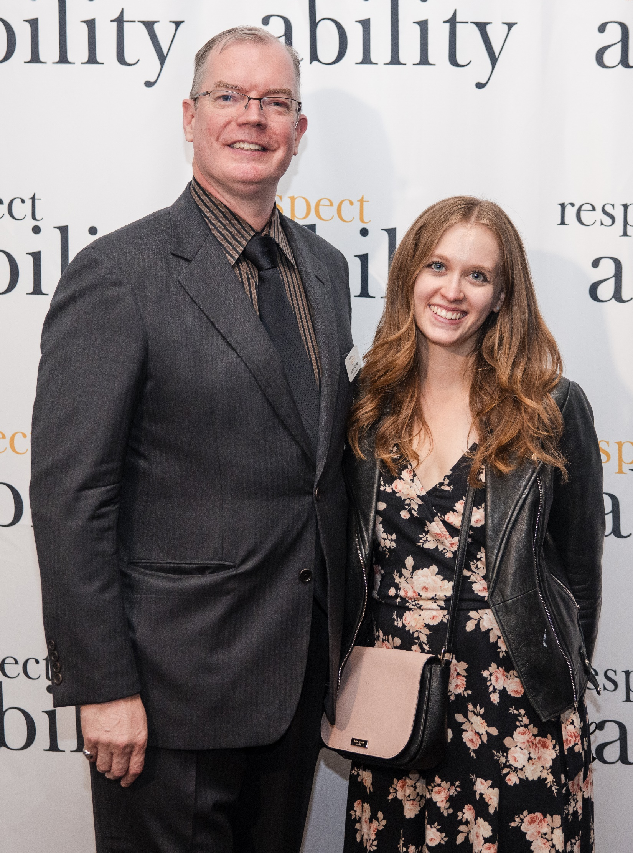
Language Matters!
Some people prefer person-first language – “person with a disability" – and others prefer identity-first language – “disabled person”
Avoid outdated terms like “handicapped,” “crippled” or the “R” word
Ask the person what language they prefer and respect their preference
Just remember: A-T-P! Ask the Person!

Slide 35
Continue Your Disability Inclusion Journey
Free resources and past webinar recordings available at www.RespectAbility.org/Resources
Want to customize a training for your team? Email JakeS@RespectAbility.org for more information.

Slide 36
For More Information
Graciano Petersen, Vice President, Talent, Culture and Learning at RespectAbility: GracianoP@RespectAbility.org
Jake Stimell, Senior Associate, Training & Learning: JakeS@RespectAbility.org

